Slide 1
Thinking in Sequences
Streams in Node.js & IO.js
Artur Skowroński

Slide 2
Node Streams 101

Slide 3
Streams Are Part of Sequence

Slide 4
Streams Are Composable

Slide 5

Streams Are Event Emmiters

Slide 6
Source
Streams Parts

Slide 7
Source
Pipeline
Sink
Streams Parts

Slide 8
Source
Pipeline
Sink
Streams Parts

Slide 9
Transformation 1
Transformation 2
EVENTS:
data
end
Streams Flow

Slide 10
Streams1
Deprecated
Aka. Push Streams

Slide 11
Readable
Writable
Kinds of Streams

Slide 12
Readable Stream
request.on('data', function(data){
response.write(transform(data))
});
Writable Stream
request.on('end', function(){
response.end()
});
Easiest thing that can possibly work… can it?

Slide 13
request.pipe(response)
request.pipe(transform).pipe(response)
Chaining

Slide 14
?
Backpressure?

Slide 15
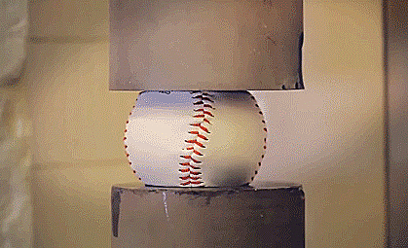
Streams
App

Slide 17
request.on('data', function(data) {
if (response.write(data) == false){
}
});
request.pause();
response.on('drain', function(data) {
request.resume();
});
Readable.resume() & Readable.pause()

Slide 18


Slide 19
Streams2
Aka. Pull Streams
v 0.10

Slide 20
Streams1
Streams2
Readable
Transform
Writable
Duplex
Passthrough
Kinds of Streams

Slide 21
Readable Streams
…strikes back

Slide 22
What ?

Slide 23
fs.createReadStream('file1.txt')
gulp.src('client/templates/*.jade')
Examples

Slide 24
How ?

Slide 25
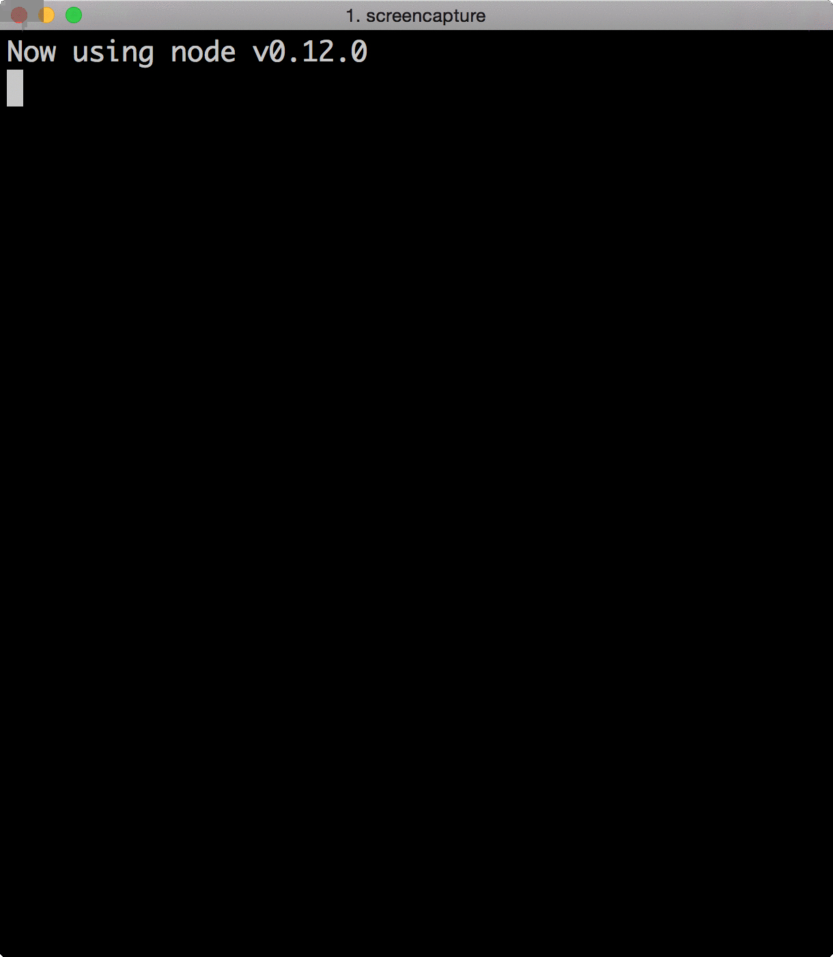
var RStream = require('stream').Readable;
var rs = new RStream;
rs.push('First \n');
rs.push('Second \n');
rs.push('Third \n');
rs.push(null);
rs.pipe(process.stdout);
Example 1

Slide 26


Slide 27
var Readable = require('stream').Readable
util.inherits(RStream, Readable);
var RStream = function (options){
Readable.call(this, options)
}
Subclass stream.Readable

Slide 28
var data = ["First”, "Second”, "Third”];
var curIndex = 0;
RStream.prototype._read = function() {
if (curIndex === data.length)
return this.push(null);
var item = data[curIndex++];
this.push(item);
}
Overwritting _read(size) function

Slide 29
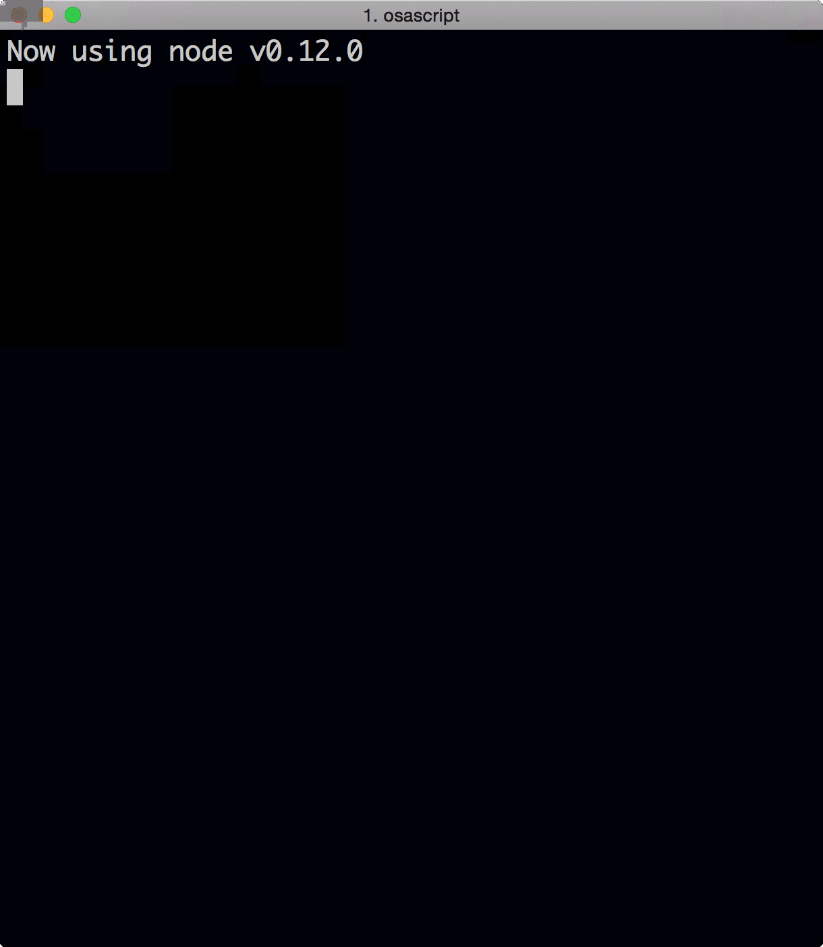
var readFunct = function(el){
log('received:' + el);
}
str.on('data', readFunct);
str.on('end', function() {
log('All consumed');
});
Example 2 – Flowing Mode

Slide 30
var readFunct = function(){
while (null !== (el = str.read())) {
log('received:' + str.read()
}
}
str.on('readable', readFunct);
str.on('end', function() {
log('All consumed');
});
Example 3 – Non-Flowing Mode

Slide 31
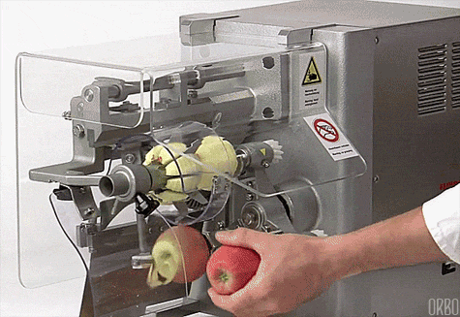

Slide 32
Writable Streams
Streams2 Edition

Slide 33
What ?

Slide 34
fs.createReadStream('file1.txt')
gulp.src('client/templates/*.jade')
Examples

Slide 35
How ?

Slide 36
var Writable = require('stream').Writable
util.inherits(WStream, Writable);
var WStream = function (options){
Writable.call(this, options)
}
Subclass stream.Writable

Slide 37
var WSImpl = function(chunk, encoding, callback) {
console.log('write: ' + JSON.stringify(chunk));
callback();
};
WriteStream.prototype._write = WSImpl
Example 1

Slide 38
var WSImpl = function(chunk, encoding, callback) {
http.request(“foo.bar?p=" + chunk, function(resp){
resp.on(‘end’, callback);
})
};
Example 2

Slide 39
Transform Streams
…I got a power

Slide 40


Slide 41

var Transform = require('stream').Transformable
…
Var TStream = function (options){
Transform.call(this, options)
}
Subclass stream.Writable

Slide 42
var TSImpl = function(chunk, encoding, callback) {
console.log('transform : ' + chunk.toUpperCase());
this.push(chunk.toUpperCase());
callback();
};
TransformStream.prototype._transform = TSImpl
How

Slide 43
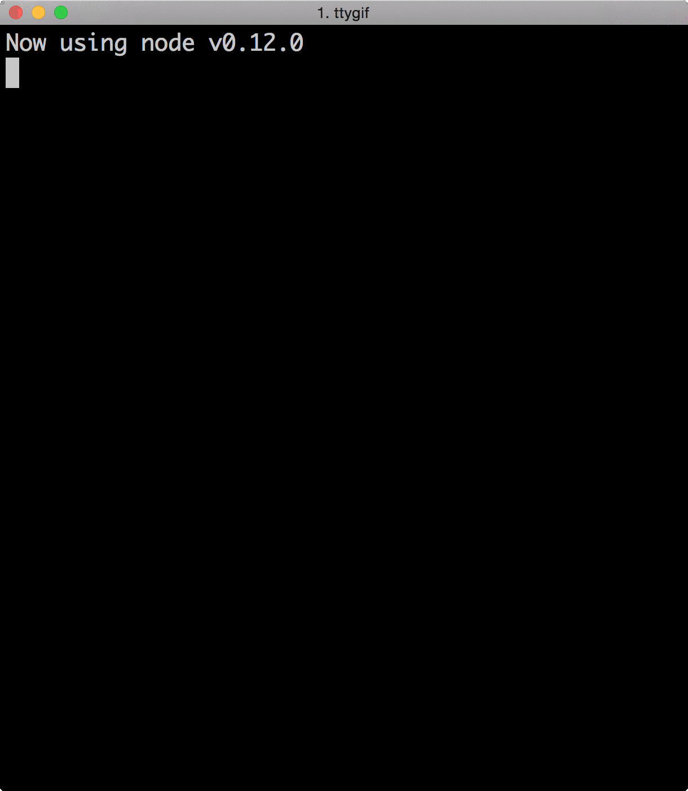
readableStream
.pipe(tranformStream)
.pipe(writableStream)
Example

Slide 44
Duplex Streams
God With Two Faces

Slide 45
Passthrough Streams
…because I can

Slide 46
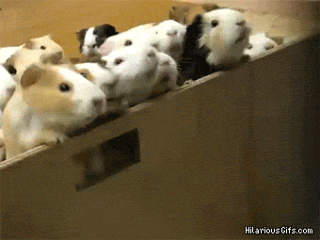
Streams 2

Slide 47
readable-stream
through2
concat-stream
Awesome NodeJS - Streams
https://github.com/sindresorhus/awesome-nodejs#streams

Slide 48
Streams3
Aka. Combined Streams
v 1.0
v 0.11.5

Slide 49
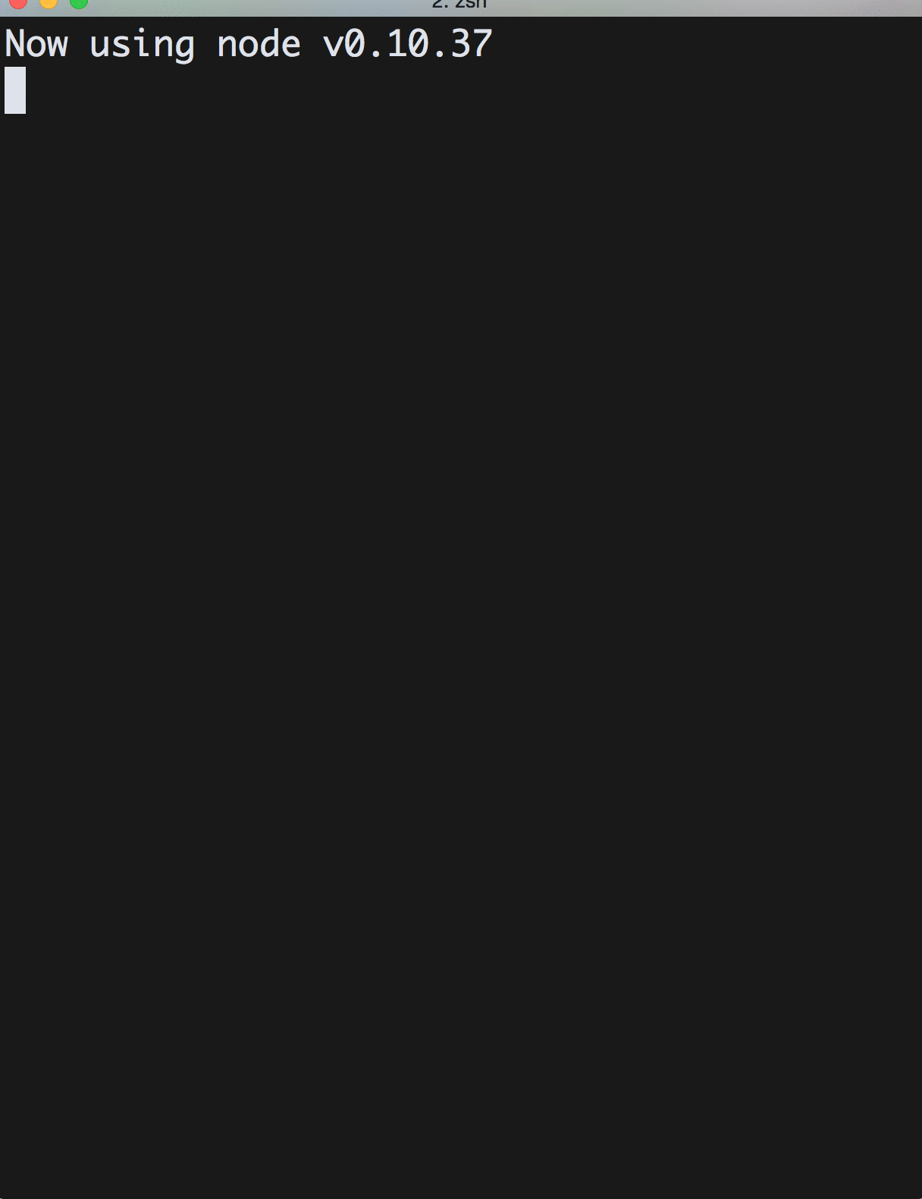
stream.on('data', function(chunk) {
pushData += chunk;
});
stream.on('readable', function() {
while(var chunk = stream.read()) {
pullData += chunk;
}
});
Pull Push – Streams2 – data event first

Slide 50
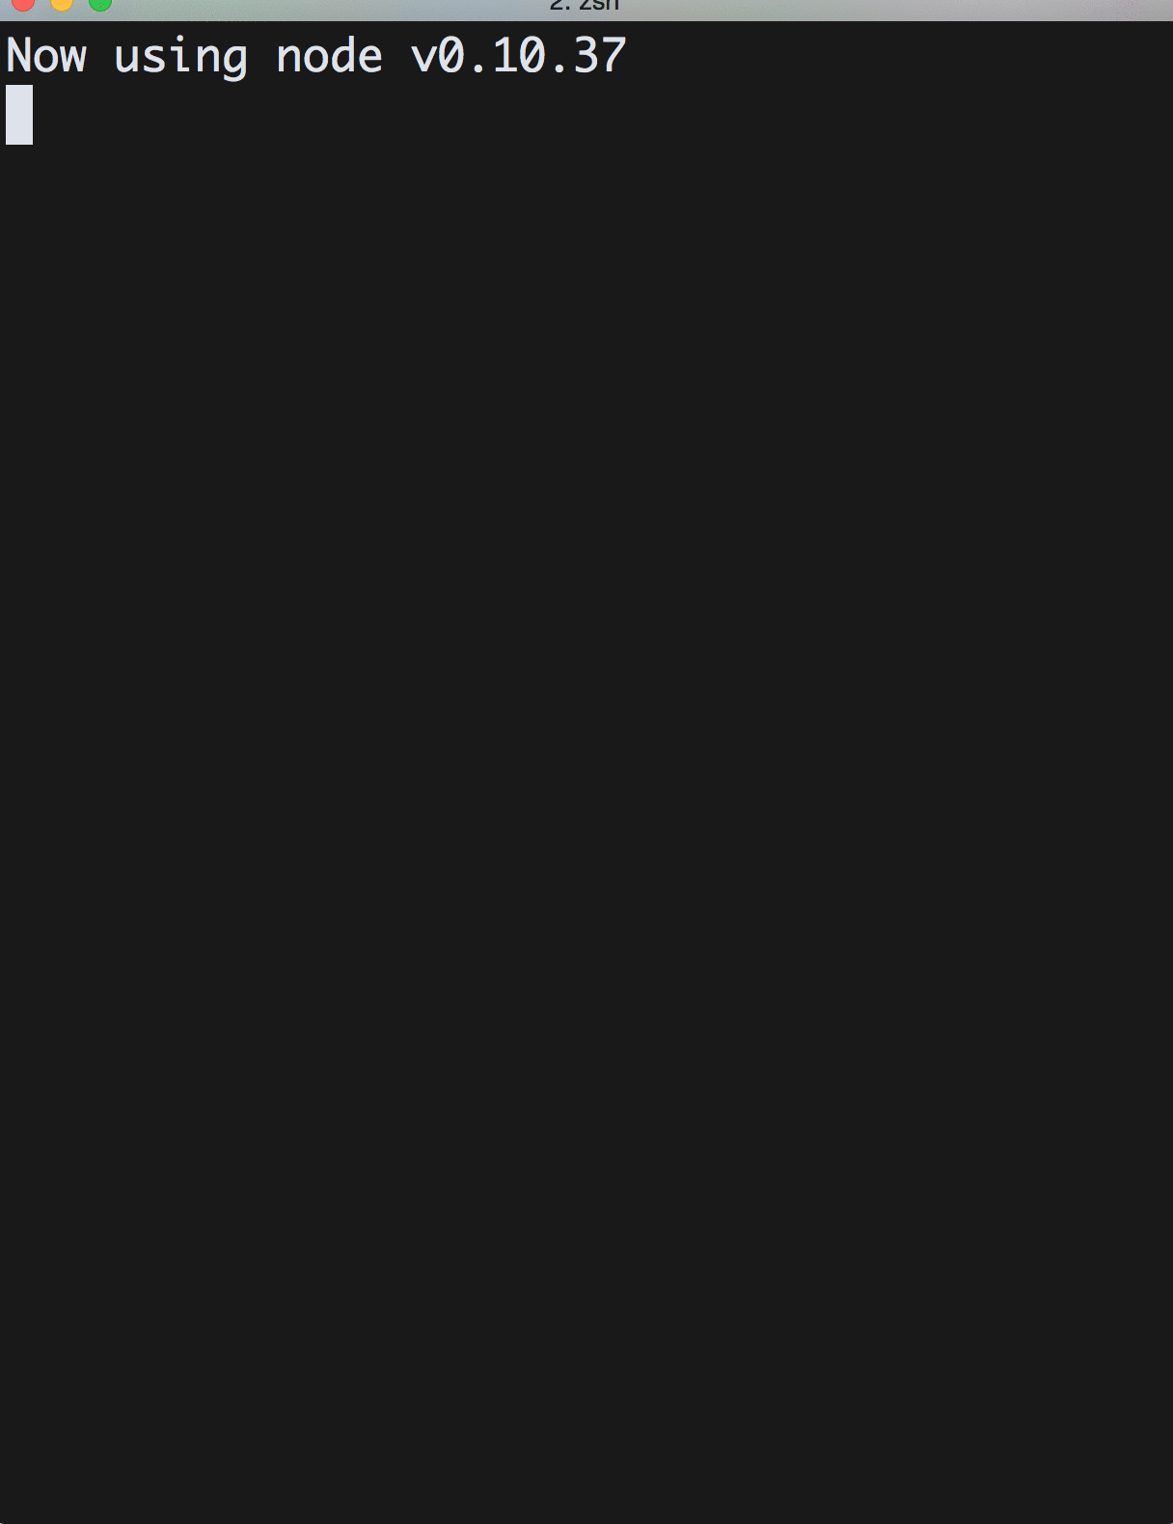
stream.on('readable', function() {
while(var chunk = stream.read()) {
pullD += chunk;
}
});
stream.on('data', function(chunk) {
pushD += chunk;
});
Pull Push – Streams2 -
Pull Push – Streams2 – readable event first

Slide 52
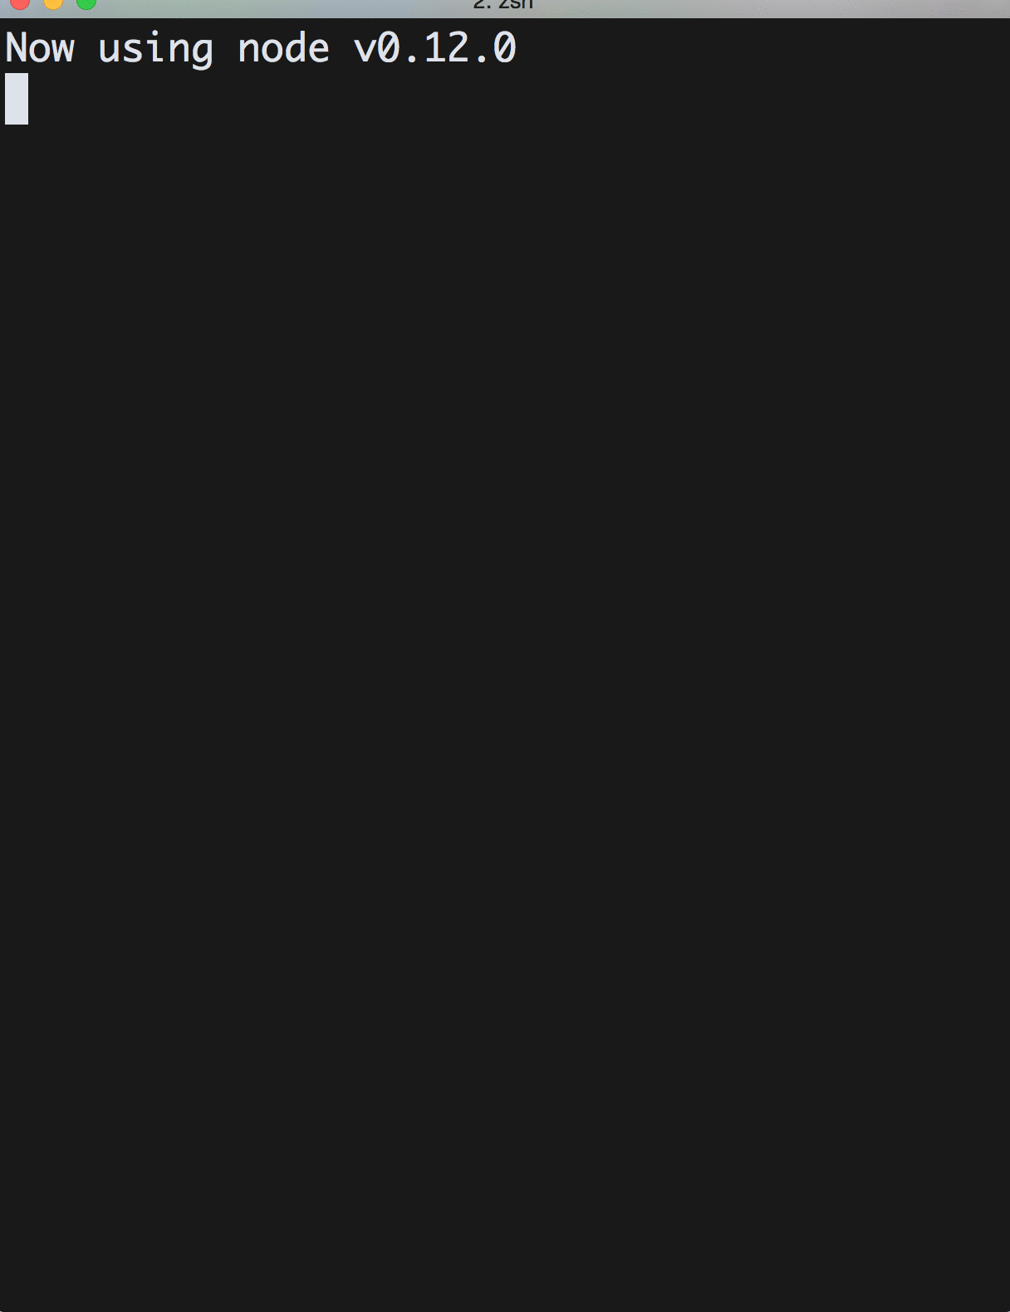
stream.on('readable', function() {
while(var chunk = stream.read()) {
pullD += chunk;
}
});
stream.on('data', function(chunk) {
pushD += chunk;
});
Pull Push – Streams3

Slide 53


Slide 54


Slide 55
HIGHLAND
npm install highland
https://github.com/caolan/highland

Slide 56
Node.js Streams Playground
http://nodestreams.com/
Node.js School – Stream Adventure
http://nodeschool.io/
Streams Handbook
https://github.com/substack/stream-handbook
Links

Slide 57


Slide 58
Artur Skowroński
Thank You!
… and waiting for questions!
@ArturSkowronski
arturskowronski.com
github.com/ArturSkowronski
slideshare.net/ArturSkowroski

